Slide 1
ResNet

Slide 2
Deep Residual Learning
152 layers network
1st place on ILSVRM 2015 classification task
1st place on ImageNet detection
1st place on ImageNet localization
1st place on COCO detection
1st place on COCO segmentation

Slide 3
Deeper Network?
Is deeper network always better?
Vanishing/exploding gradients?
Better initialization methods / batch normalization / ReLU
Degradation problem: more depth but lower performance
Overfitting?

Slide 4
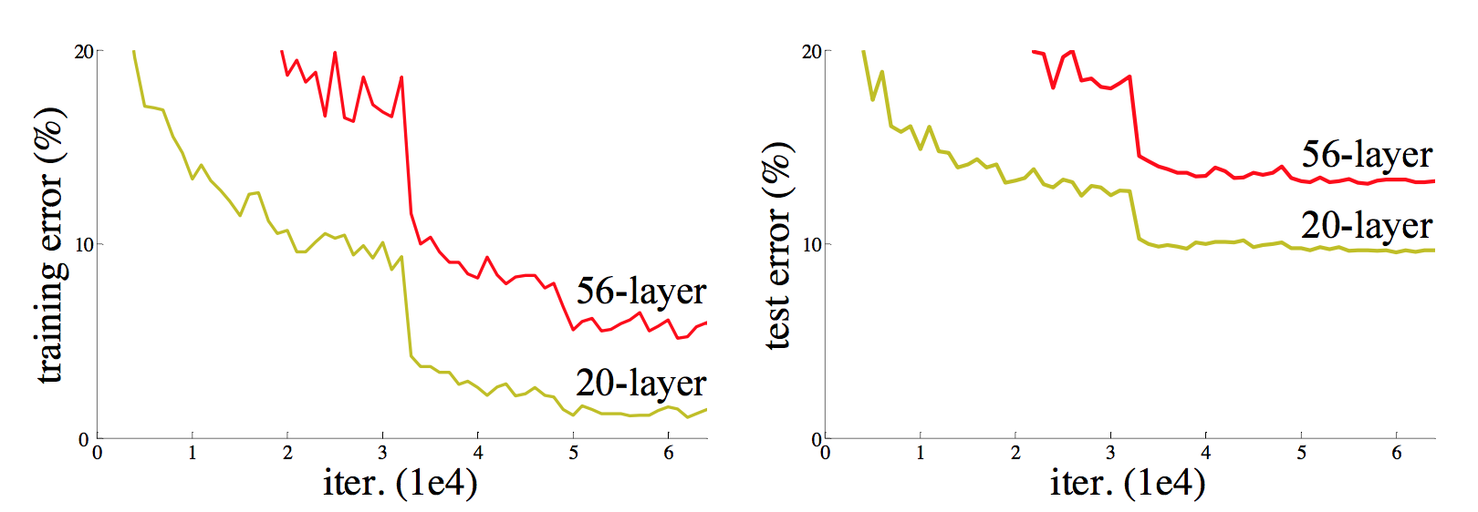
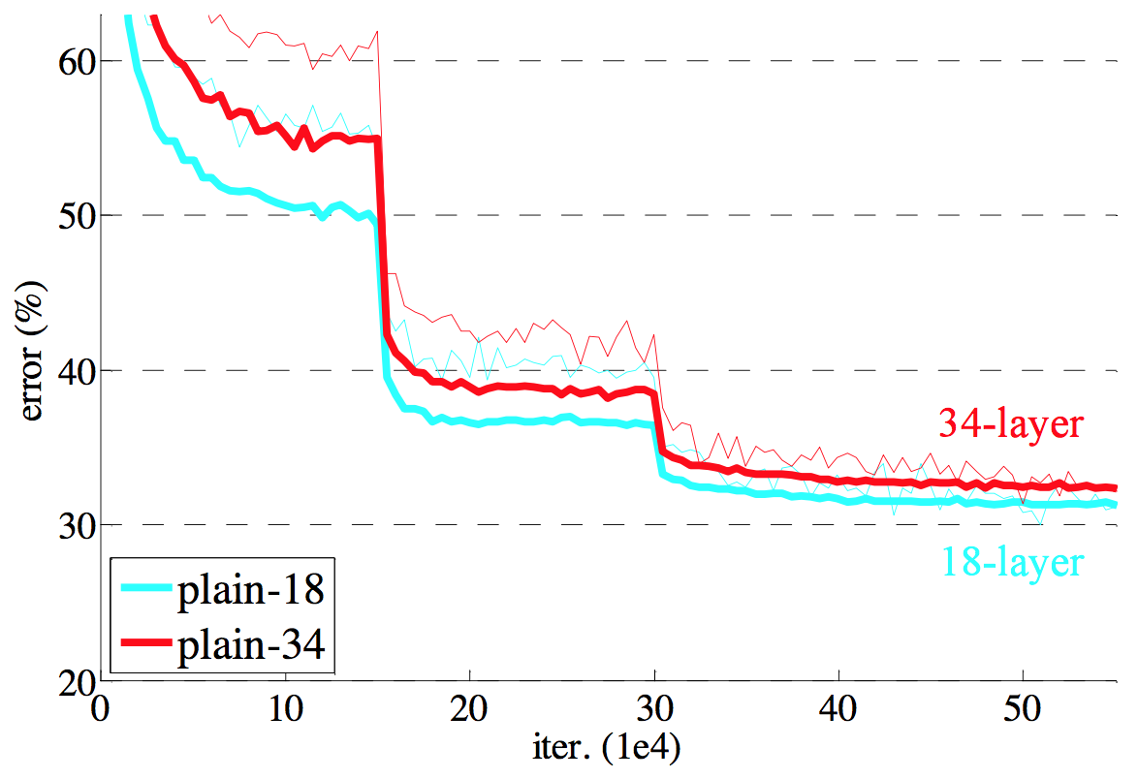
Degeneration Problem
CiFAR 100 Dataset
ImageNet

Slide 5
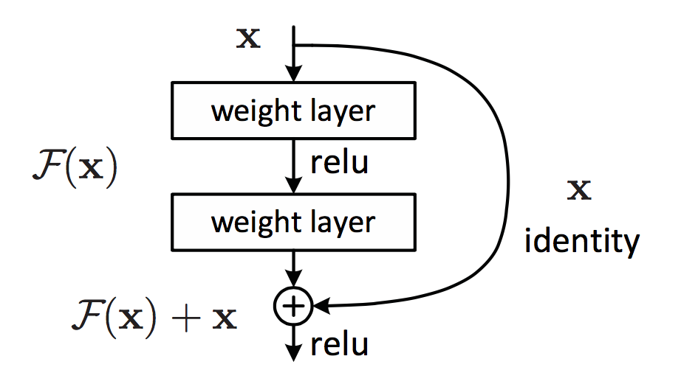
Residual Learning Building Block

Slide 6
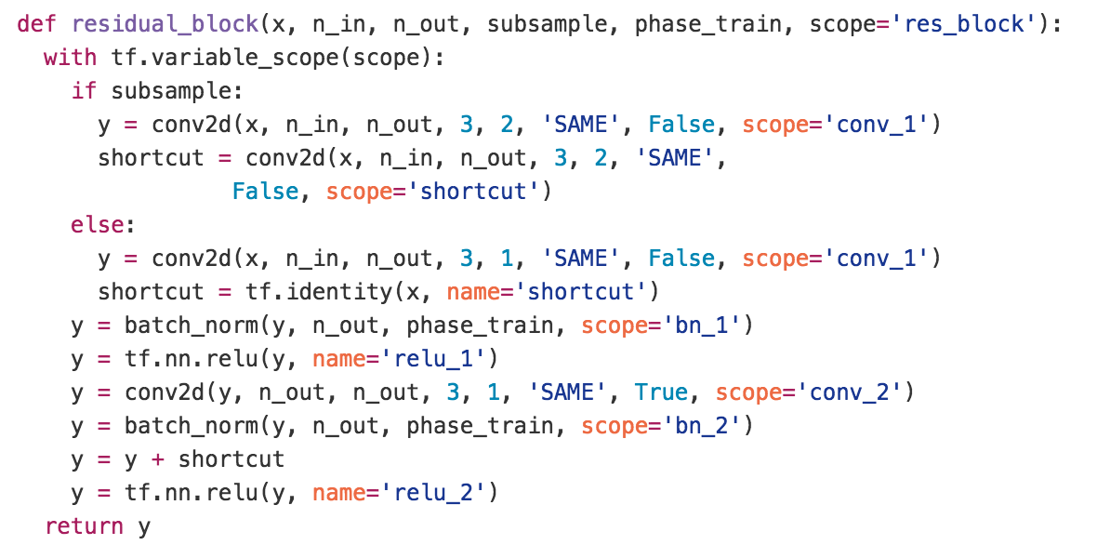
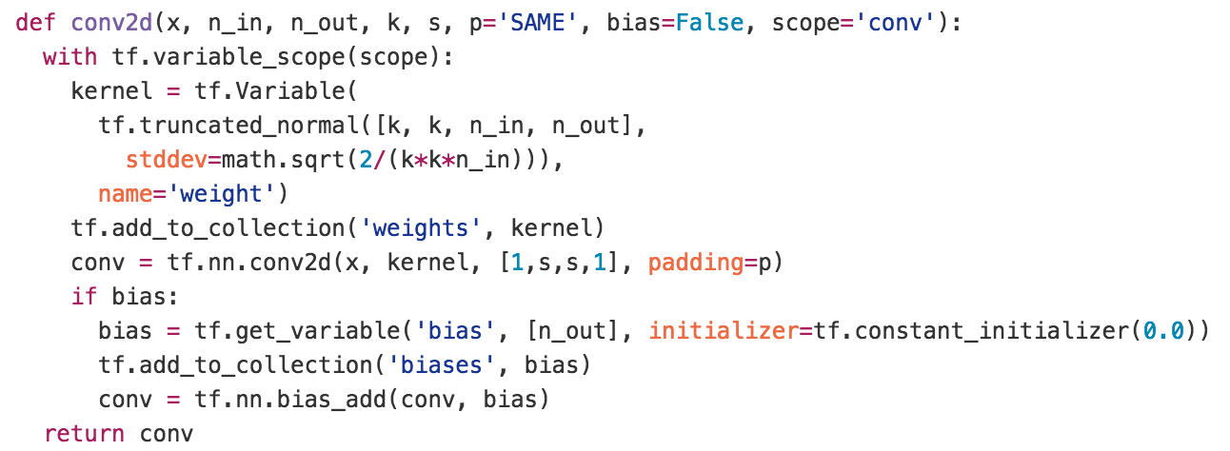
Residual Learning Building Block
y
ReLU
+
y
conv2d
y
ReLU
y
conv2d
x

Slide 7
Why?
We hypothesize that it is easier to optimize the residual mapping than to optimize the original, unreferenced mapping.
Shortcut connections are used.

Slide 8
From Comprehensive Experiments,
The extremely deep residual nets are easy to optimize.
The deep residual nets can easily enjoy accuracy gains from greatly increased depth, producing results substantially better than previous networks.

Slide 9
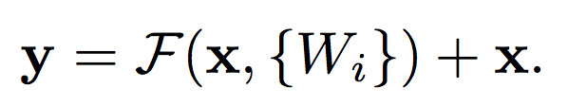


Deep Residual Learning
Basic residual mapping (same dim.)
“But we will show by experiments that the identity mapping is sufficient for addressing the degradation problem and is economical, and thus W is only used when matching dimensions.”
Basic residual mapping (different dim.)

Slide 10
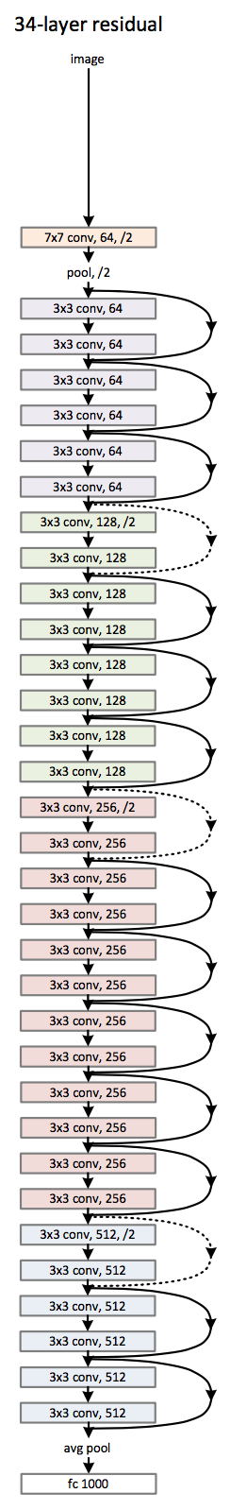
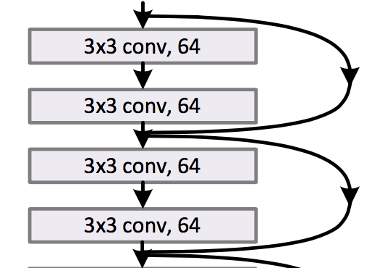
Deep Residual Network

Slide 11
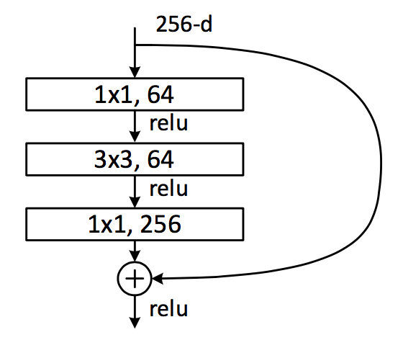
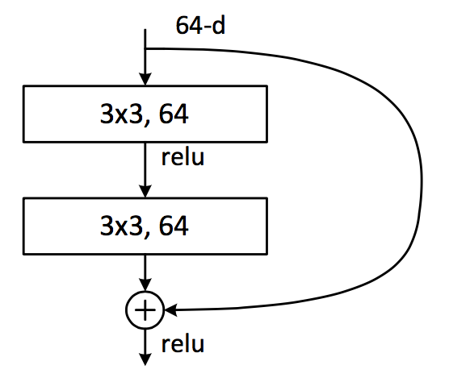
Deeper Bottleneck Architecture
Dimension reduction
Convolution
Dimension increasement

Slide 12
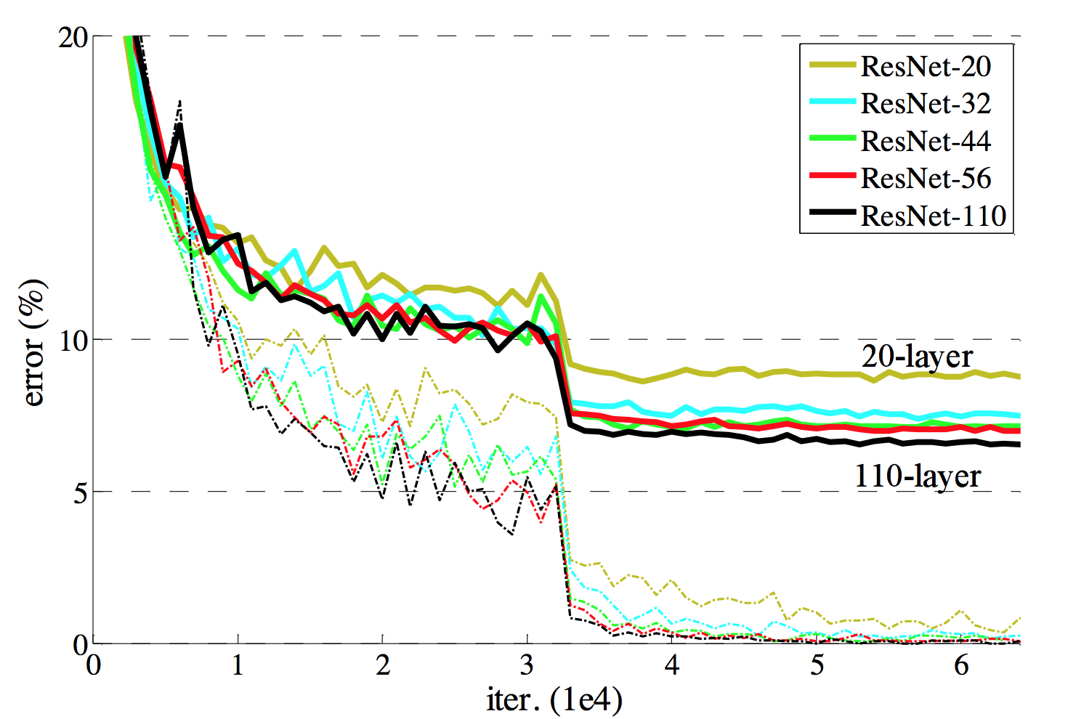
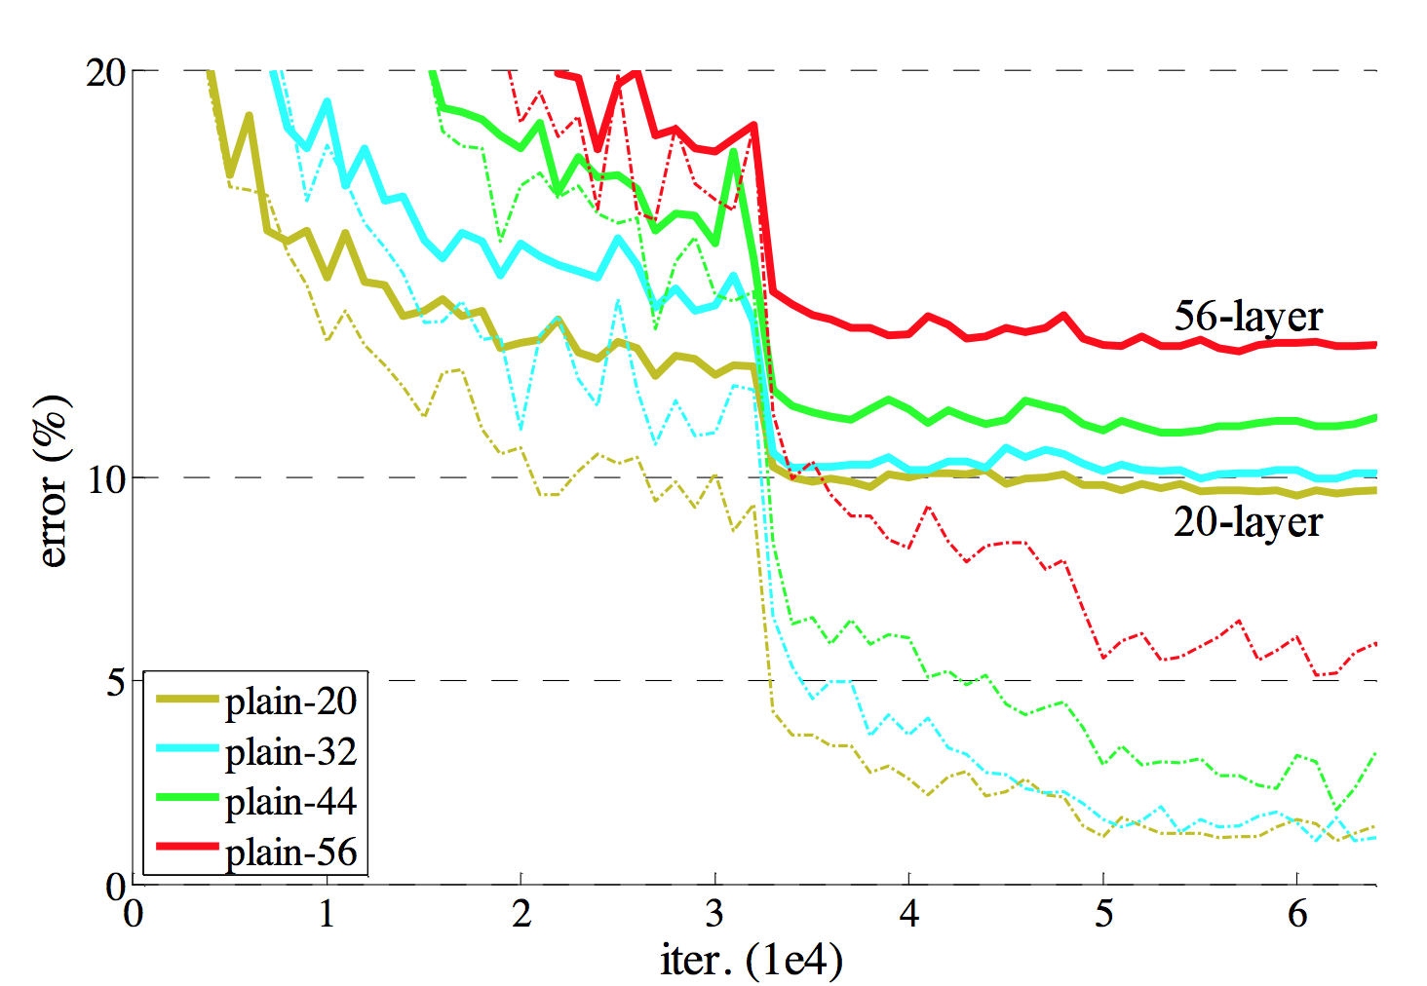
Results

Slide 13
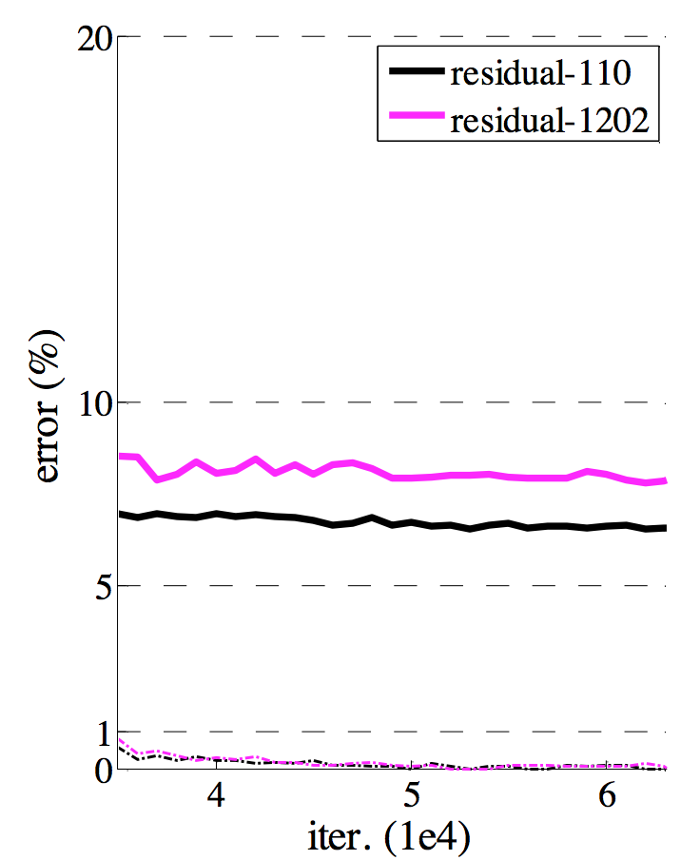
Results

Slide 14


